Slide 1


CSS

Slide 2
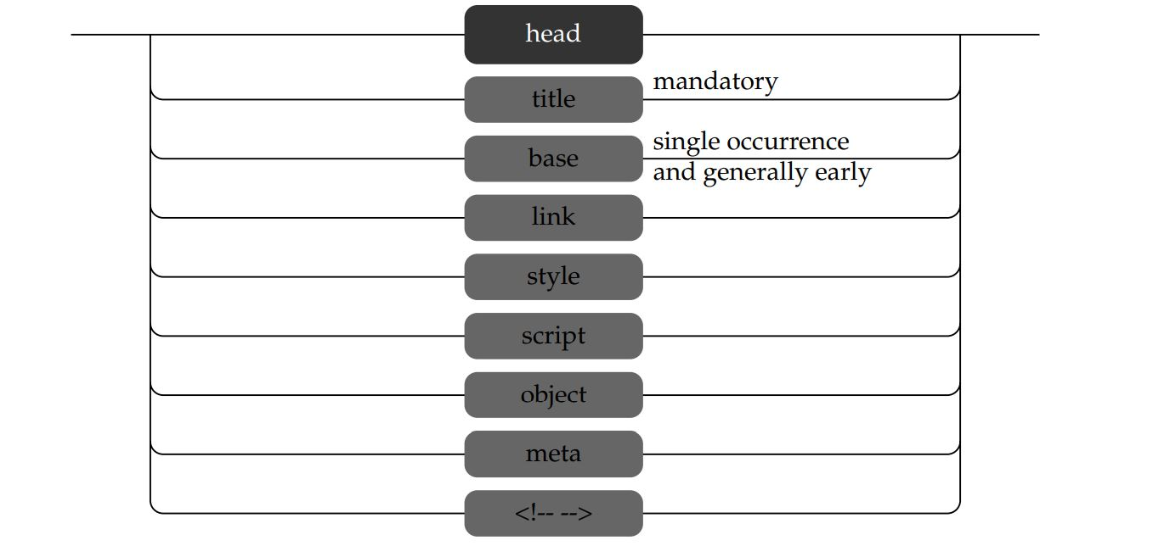


Head structure
Title
link
Style
Script

Slide 3
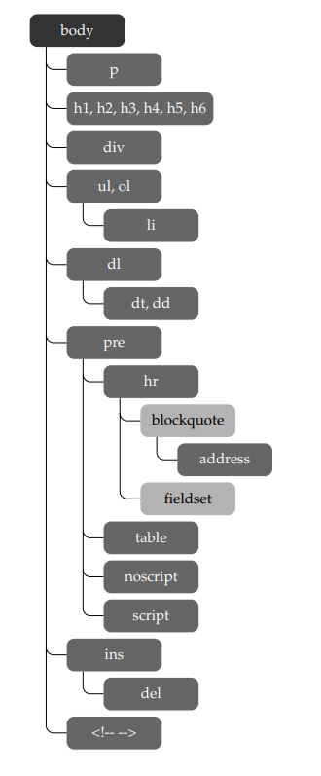
Body structure

Slide 4
Difference between b and strong tags

Slide 5
Section element

Slide 6
Header footer

Slide 7
article

Slide 8
aside
HTML5 also introduces an aside element, which may be used within content to represent material that is tangential or, as the element name suggests, an aside:

Slide 9
mark
The new HTML5 element mark was introduced for highlighting content similarly to how a highlighter pen might be used on important text in a book. The following example wraps a few important words

